Slide 1
Bluetooth module
it a great solution for wireless communication.
The Bluetooth module HC-05 is a MASTER/SLAVE module. By default the factory setting is SLAVE.
Master module can initiate a connection to other devices
The slave modules cannot initiate a connection to another Bluetooth
device, but can accept connections.

Slide 2
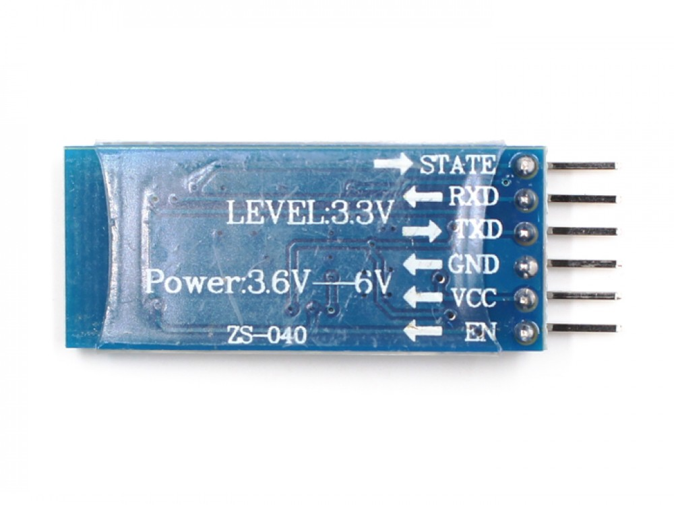
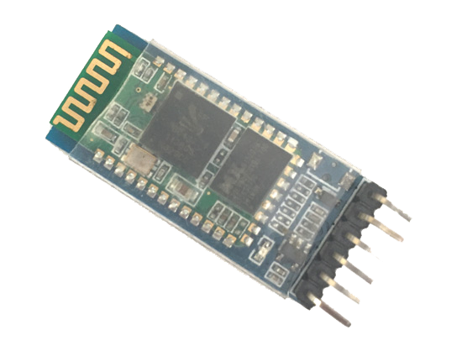
Bluetooth module contd….

Slide 3
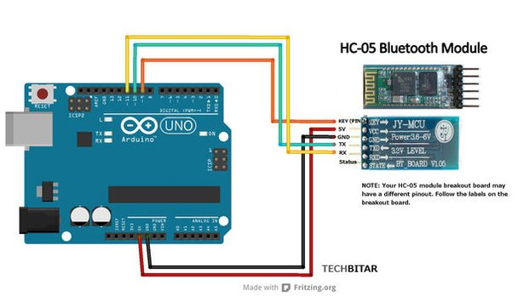
Connection diagram

Slide 4


Slide 5
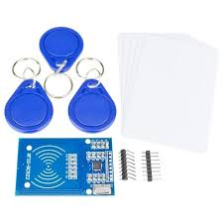
Rfid
It stands for Radio-Frequency Identification
Uses electromagnetic fields to automatically identify and track tags
attached to objects.

Slide 6
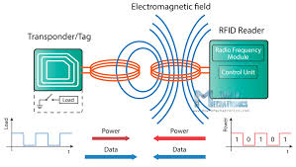
Working principle
Works on the principle of electromagnetic induction.
RFID reads the code written in RFID tag and sends to the controller.
Controller does the work according to the info written in RFID tags.

Slide 7

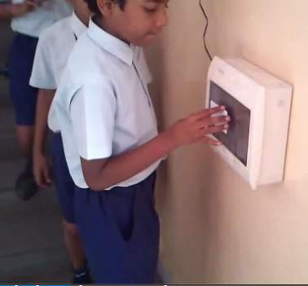

Applications :
Access control.
Library management
Product tracking in Supermarket
Smart Attendance system
Traffic management system
Smart payment

Slide 8

How with Arduino??

Slide 9
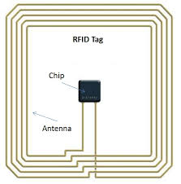
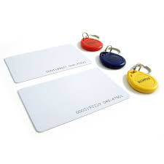
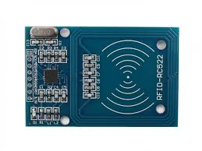
We use Arduino compatible module named as: RFID-RC522
It generally contains two components:
RFID Reader
RFID tag
RFID tags
Inside Tag
RFID reader

Slide 10
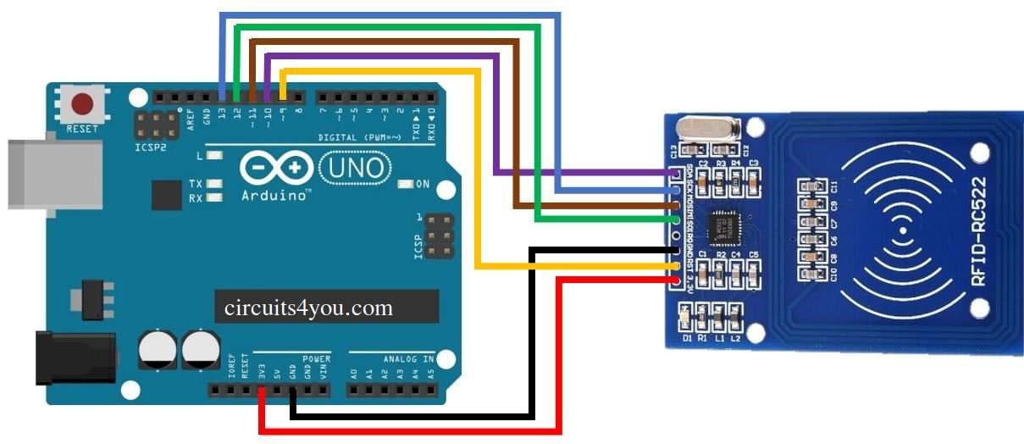
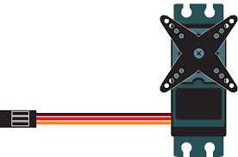
Connection Diagram
A R
13 – SCK
12 – MISO
11 - MOSI
10 - SDA
9 - RST
GND - GND
3.3 - 3.3

Slide 11


Slide 12
Thank you

